Slide 1
A Good Soldier Or Random Exposure?
A Stochastic, Accumulating Mechanism To Explain Frequent Citizenship
Dissertation Defense
Christopher R. Dishop

Slide 2
Random Requests

Slide 3
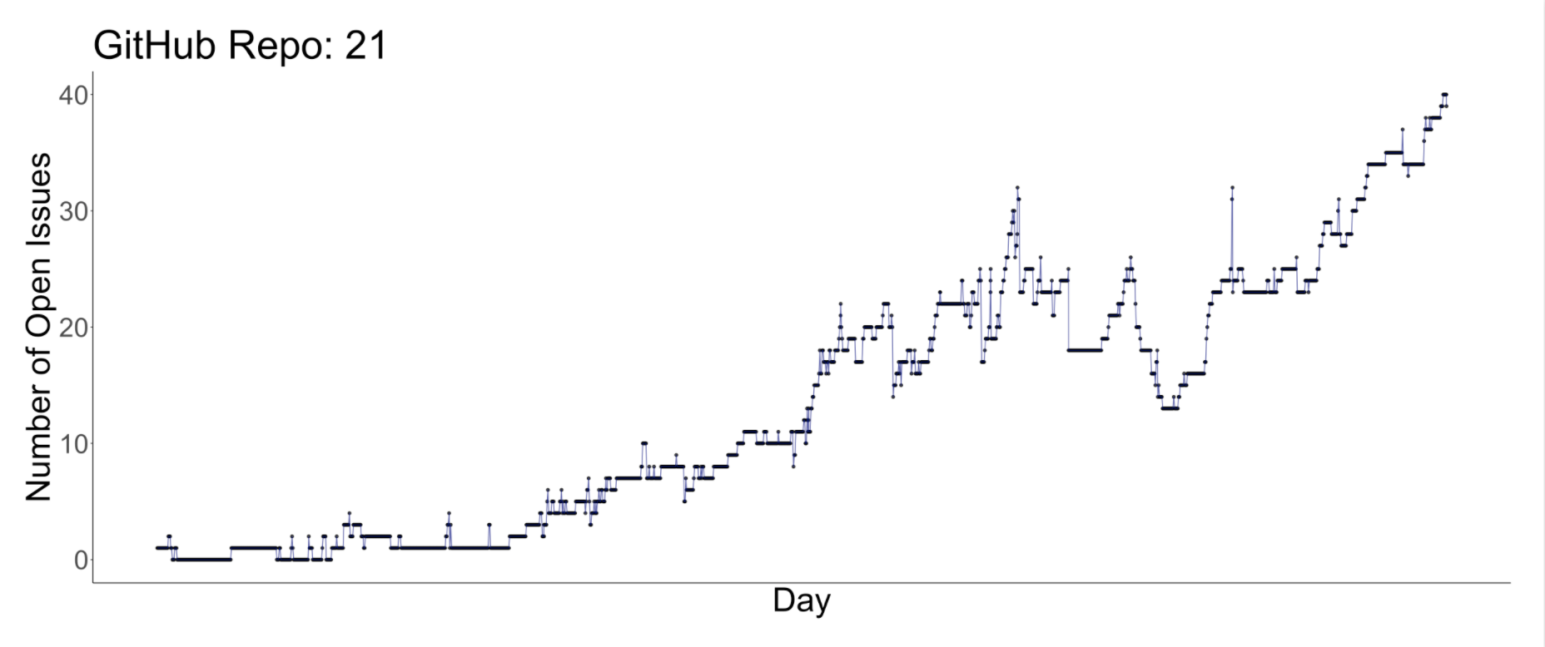
Random Requests

Slide 4
Random Requests

Slide 5
Random Requests

Slide 6



Random Requests

Slide 7
Social Capital & Sustained Lead

Slide 8
Situation x Person

Slide 9
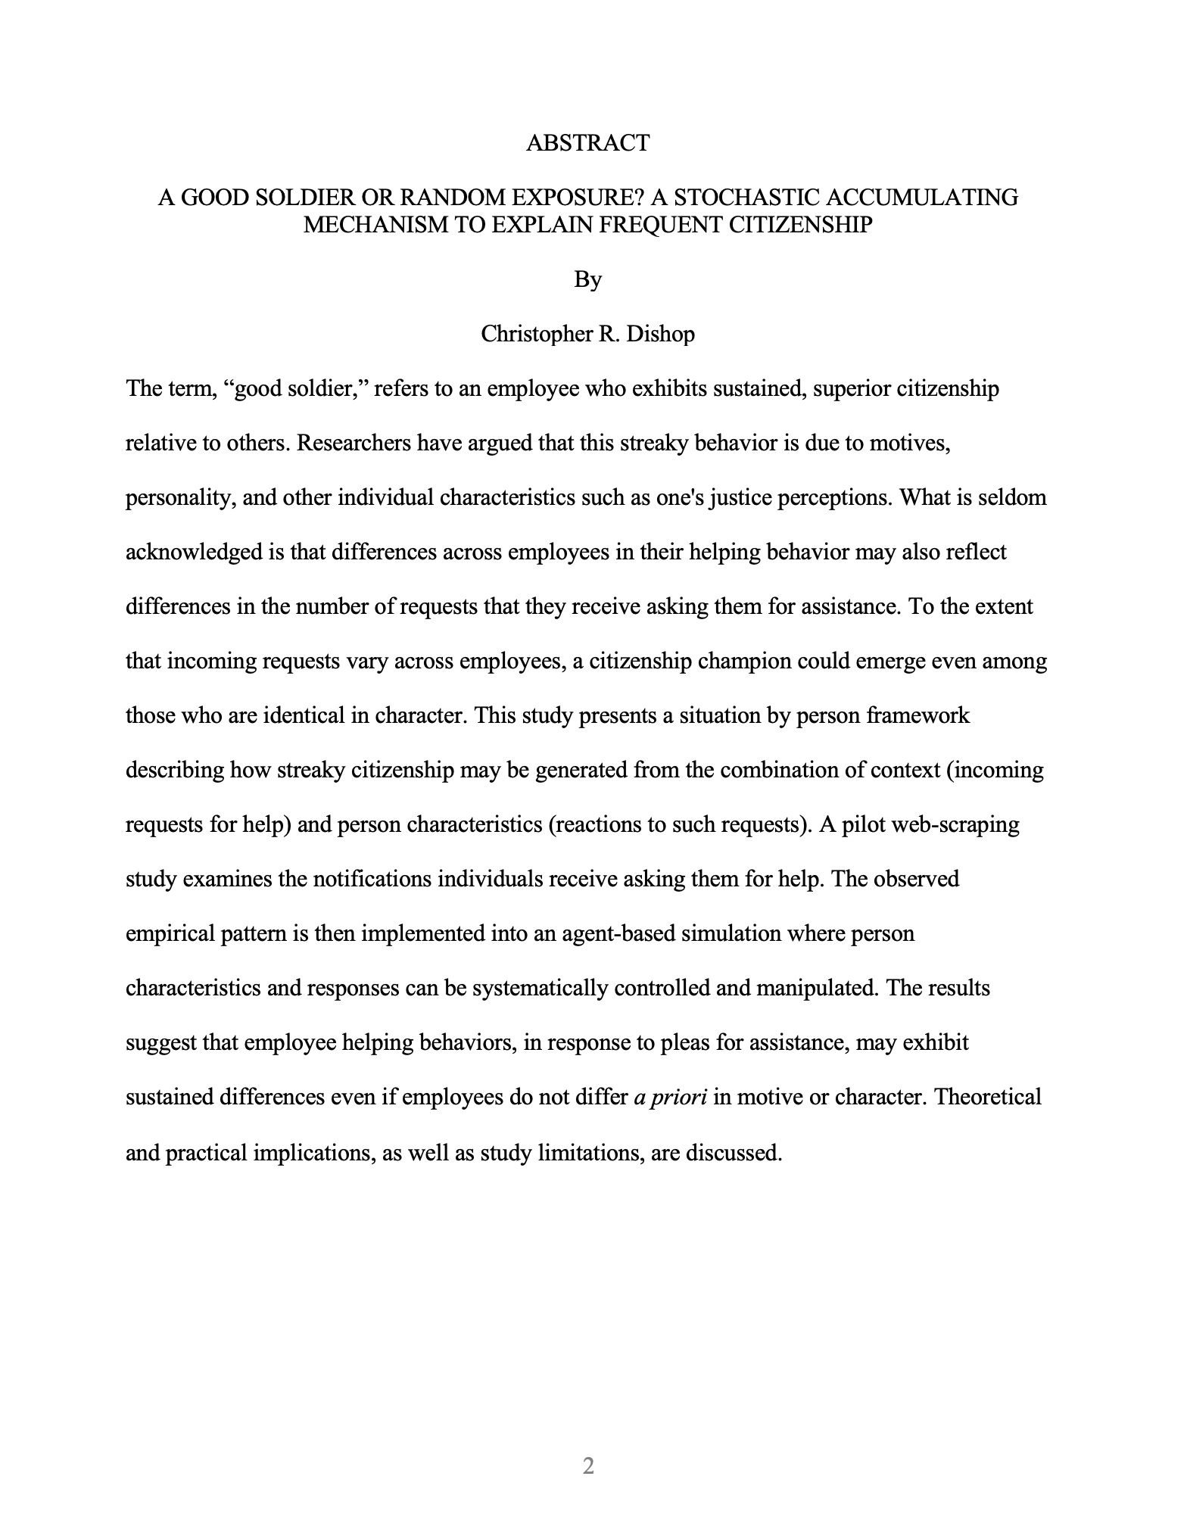
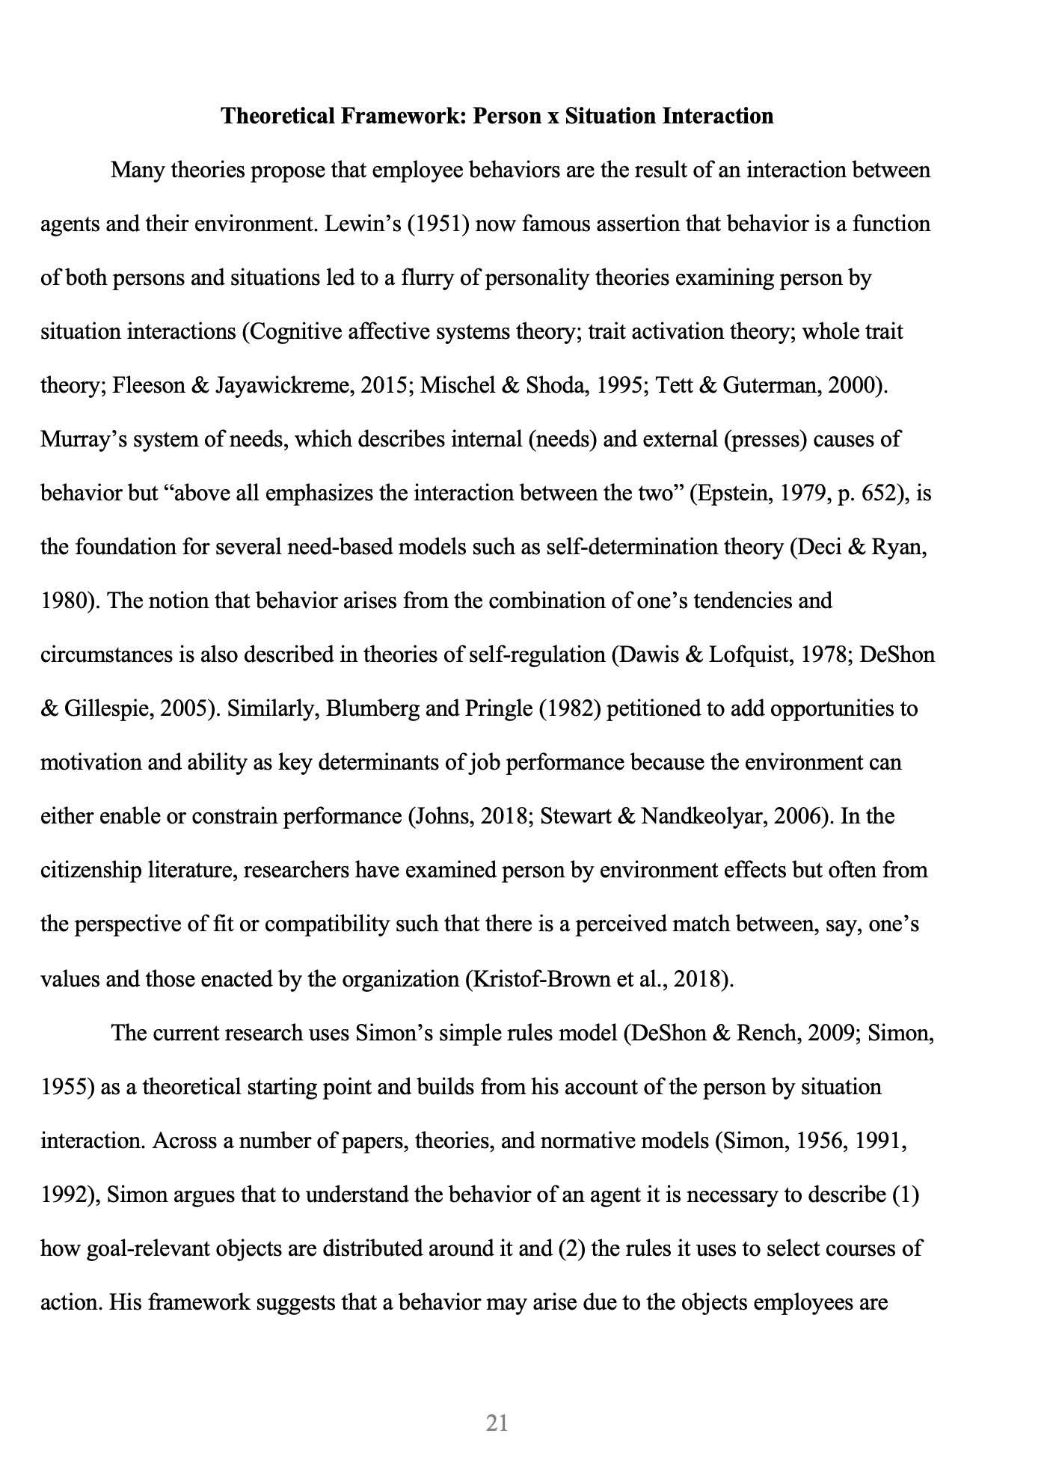
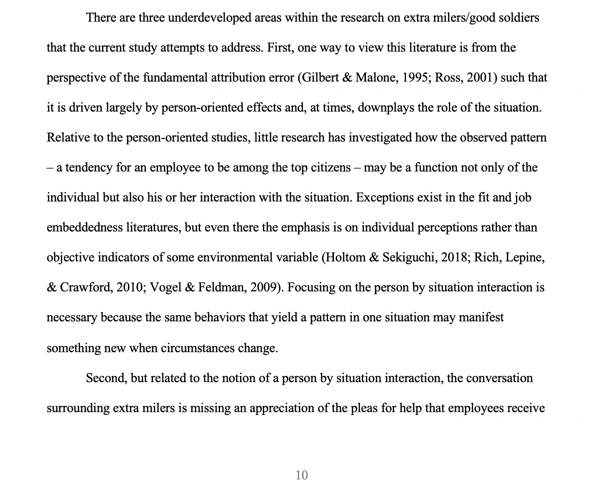
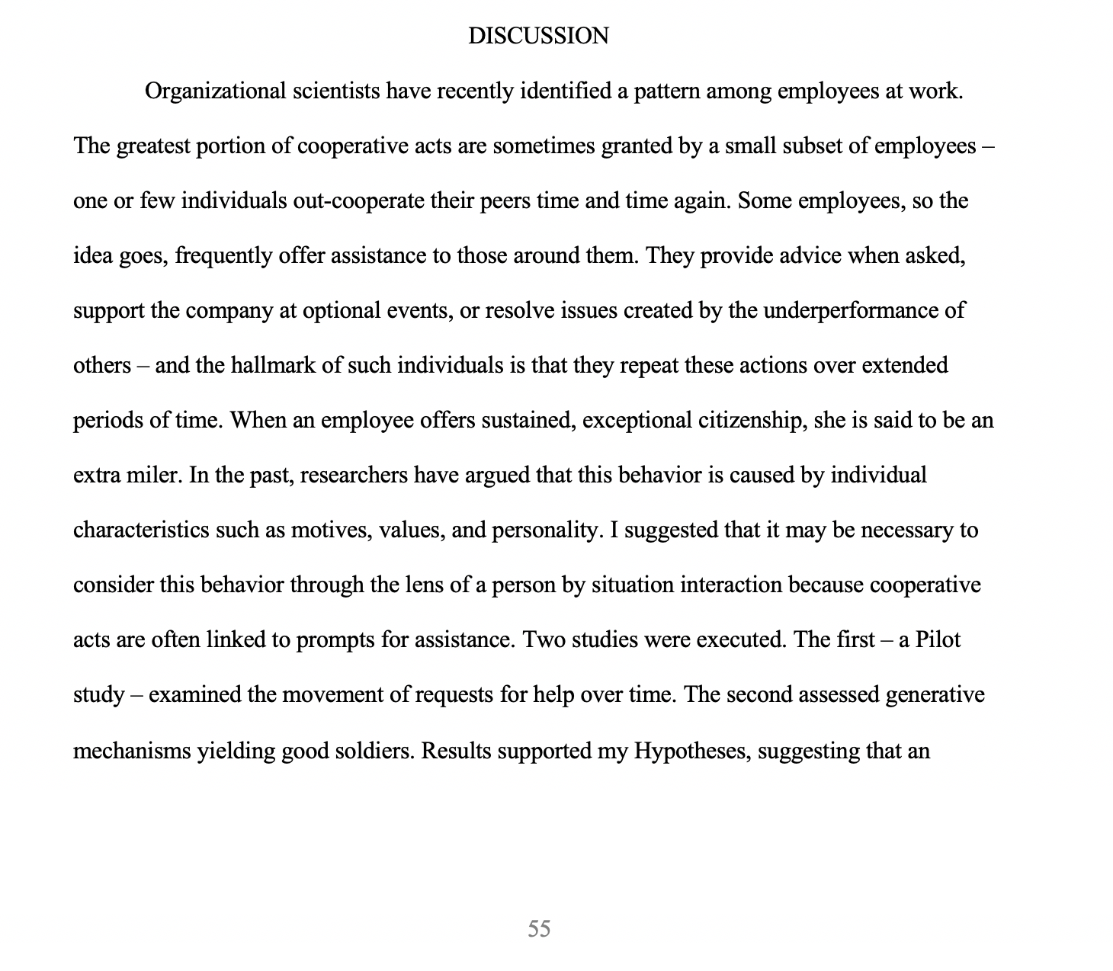
Situation x Person
Abstract
3rd Paragraph Intro
Theory
Discussion

Slide 10
Attribution Error & Manager Perceptions

Slide 11
Opportunities Language

Slide 12
Random Requests
Still some issues
I don’t clarify until page 18
Still in title
Last reason “is most important.” Say it again in methods. Say it again in Discussion.
I could focus on sustained lead. If you have sustained lead…this is what happens…
Why do I like random? Priority in longitudinal analysis. How many other students know about the arcsine law?

